Slide 1
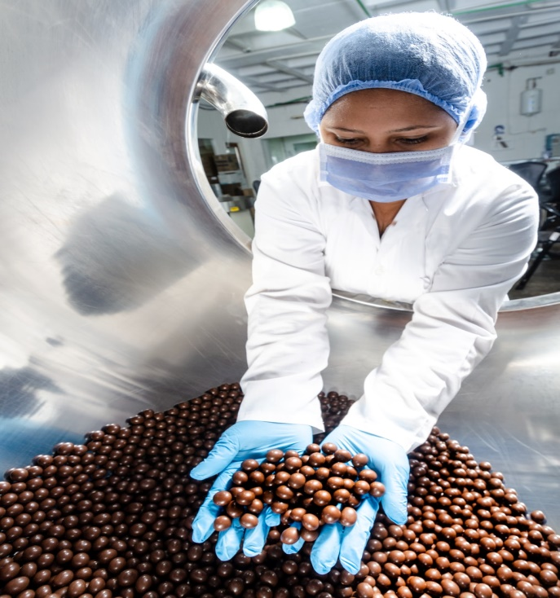
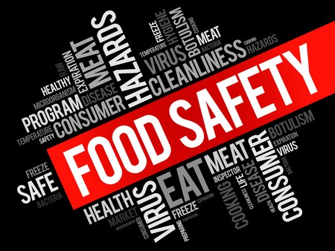
ISO 22000:2018
FOOD SAFETY MANAGEMENT SYSTEMS

Slide 2






In House Team
Chaminda Karunanayake
-Director Business Development –
(MSc Herriot Watt, MBA-USQ, PhD candidate (Sri Jaya))
Sugath Hettiarachchi
-Director System implementation-
(DOSH, DQA, Lead Auditor EMS,QMS, OHMS, BSc-Colombo)
Madusha Sewwandi
-QA & Project Lead-
(HND-Food Science)
Isuru Denagamage
-Marketing & Brand Executive
(BSc (Hons) in Agriculture, PGdip Marketing (SLIM) )
Asheni Silva
-Compliance Specialist-
(LLB-UK, LLM-Candidate)
Pravinda Bhagya
-Consultant-
BSc, MSc, PhD(Candidate-Aus)

Slide 3















Our Experience

Slide 4
What is ISO 22000:2018
A set of requirements for a Food Safety Management System (FSMS)
It was developed to fill the need for a worldwide Food Safety Standard
The 22000 Standards, ISO and FSSC 22000
Many standards already exist worldwide.
ISO 22000 and FSSC 22000 have global acceptance.
FSSC 22000 is a GFSI Benchmarked standard.

Slide 5
ISO 22000
Applies to all stages of the supply chain
Aligned with ISO 9001 to enhance compatibility with existing management system
FSSC 22000
Applies to Food Manufacturers.
Contains the requirements of ISO 22000 and the ISO/TS 22002-1,or ISO/TS 22002-4
ISO/TS 22002-1contains specific requirements for prerequisite programs (PRPs).
The ISO/TS 22002-4 contains PRP requirements for Food Packaging Manufacturers.

Slide 6
PDCA Model
PDCA CYCLE
PLAN | Establish FSMS | Establish ISMS Policy,objectives,process and procedures relevant to managing risk and improving IS to deliver results in accordance with an organization’s overall policies and objectives.
DO | Implement and operate FSMS | Implement and operate FSMS policy,controls,processes and procedures.
CHECK | Monitor and review FSMS | Assess and where applicable measure, process performance against FSMS policy.
ACT | Maintain and Improve FSMS | Take corrective actions, based on the results of the internal audit and management review or other relevant information, to achive continual improvement of ISMS

Slide 7
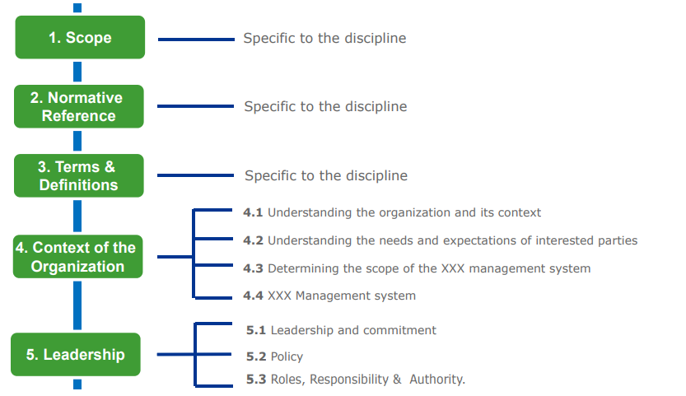
ISO 22000:2018 REQUIREMENTS AND HIGH-LEVEL STRUCTURE

Slide 8
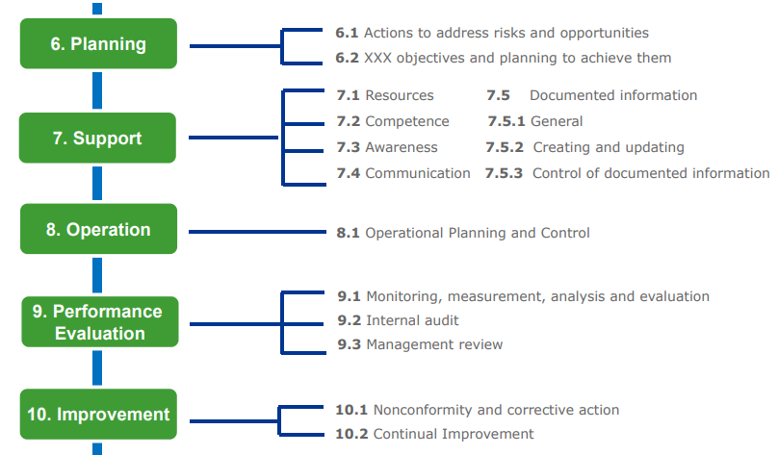

Slide 9
Clause No:04
4.4
Food Safety management system
4.1 understanding the organization & it’s context
4. Context of the Organization
4.2 understanding needs & expectation of interested parties
4.3
Determining scope of the Food Safety Management System

Slide 10
Clause No:05
5.1
Leadership & commitment
5. Leadership
5.2
Policy
5.3
Organizational Roles, responsibilities & authorities

Slide 11
Clause No:06
6.1
Actions to address risks & opportunities
6.2
Objectives of the FSMS and the planning to achieve them
6. Planning
6.3
Planning of the changes

Slide 12
Clause No:07
7.2
Competence
7.3
Awareness
7.1
Resources
7. Support
7.5.1 general
7.4 Communication
7.5
Documented information
7.5.2 creating & updating
7.5.3 control of documented information

Slide 13
Clause No:08
8.9
Control of product and process nonconformities
8.2
Prerequisite Programs(PRPs)
8.1
Operational planning & control
8.3
Traceability System
8.8
Verifications related to PRPs and the hazard control plan
8.Operations
8.4
Emergency preparedness and response
8.7
Control of monitoring and measuring
8.6
Updating the information specifying the PRPs and the hazard control plan
8.5
Hazard Control

Slide 14
Clause No:09
9. Performance evaluation
9.1
Monitoring, measurement analysis & evaluation
9.3
Management review
9.2
Internal audits

Slide 15
Clause No:10
10.1
Nonconformity & corrective action
10.Improvement
10.2
Updating the Food Safety Management System
10.2
Continual improvement

Slide 16





011 2576616 , 0777 169339, 071 600 4411
info@winyana.com , sugath@winyana.com
No. 20, Kothalawala Avenue, Colombo 04.

